Slide 1
Administering the VCCALPS: Trainer of Trainers State SELPA
April 4, 2019
Joanna V. Della Gatta, Ventura County SELPA
Cathi Nye, VCOE

Slide 2
Assessment of English Language Proficiency
Who do we test?
When do we test?
Which assessment is appropriate?
Notes:
Joanna

Slide 3
Initial/Annual Assessment of English Language Proficiency
Home Language Survey-
Initial enrollment in school TK/K-12
Given only once
Initial determinations are reported in CALPADS
Preschool English Language Survey (PELS)
English Language Proficiency Assessments for California (ELPAC)
All school age students Tk/K-12
Initial and Summative
Ventura County Comprehensive Alternate Language Proficiency Survey (VCCALPS)
For special education students only TK/K-12
Initial and Summative
Complete ELPAC scoring document as assessed using alternate
Student obtains the Lowest Obtainable Student Score (LOSS)
Not for use for IFEP
Given at the same time the ELPAC is given to all other ELs.
Notes:
Joanna: Decision to take the VCCALPS vs ELPAC is determined when student with IEP is re-assessed prior to entering kindergarten (transition to Tk/K)

Slide 4
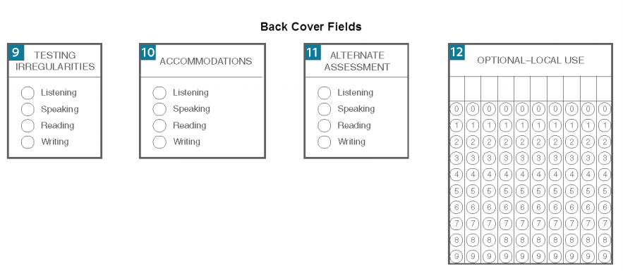
Notes:
Joanna: Picture of answer booklet

Slide 5
Initial/Annual Assessment of English Language Proficiency
A TK/K-12 student with any language other than English spoken in the home (on the Home Language Survey) must be assessed within the first 30 days of enrollment.
The results will lead to initial identification of students as English learners (ELs).
Annual summative assessment to measure a student’s progress in learning English and to identify the student’s English Language Proficiency (ELP) level
Notes:
Joanna:
Who do we test? When do we test?
Using the VCCALPS, ELPAC
ELPAC-S/ELPAC-I /VCCALPS worksheet

Slide 6
ELPAC/VCCALPS
ELPAC
VCCALPS
English Language Proficiency Assessments for California
Listening
Speaking
Reading
Writing
Ventura County Comprehensive Alternate Language Proficiency Survey
Listening
Speaking
Reading
Writing
Notes:
Joanna
.
The annual Summative Assessment window will be a four-month window after January 1 (proposed February 1 to May 31).

Slide 7
Introduction and Purpose of the VCCALPS
IEP team decision- use the Worksheet for Alternate Assessment
If any items are marked disagree, team considers using an alternate to the ELPAC or give the ELPAC with supports.
Assess language proficiency of students with moderate to severe disabilities, who because of their disability cannot access all or part of the ELPAC
Notes:
Joanna: *VCCALPS is used to assess the language proficiency of students with moderate to severe disabilities, who, because of their disability cannot access all or part of the ELPAC. These are your students who are being assessed using the CAA. You can use the worksheet for English Language Proficiency Assessment Participation Consideration as a tool to assist the IEP team in determining whether the VCCALPS or ELPAC is appropriate. Look at worksheet. If any of the items are marked “disagree,” the team should consider using the ELPAC with supports- refer to matrix 4.
Go through the worksheet with the group. Don’t have to do the worksheet page every year.

Slide 8
Introduction and Purpose of the VCCALPS
Assesses in all required areas: Listening, Speaking, Reading and Writing
Establishes levels in both the primary language and English
Results may be used in reclassifying a student to Fully English Proficient (RFEP)
Notes:
Joanna Assesses in all areas required by the CDE: listening, speaking, reading and writing. When time for tri review, student may be given other assessments to determine language proficiency, but the VCCALPS can be used for that as well.
Establishes levels in both the primary language and English. It is often difficult to establish Eng Language proficiency for our students with mod/severe disabilities because in addition to developmental and intellectual disabilities, they have delays in the areas of general language development. An analysis of proficiency in English compared to proficiency in the primary language can be very useful. The information from the VCCALPS can be used to determine whether the student is EL or a student with disabilities in language/cognition across languages.
For students who perform at low levels in both English and in the primary language, the IEP team may recommend to the ELD department at the district that the low proficiency in English is due to the disability. Although the IEP team may make the recommendation, the final decision about reclassification lies with the ELD department

Slide 9
Administering the VCCALPS
Administered over multiple sessions, in short lengths of time tolerable by the student
Due to the similarity in content for the English and primary language items, should be administered in random order, with at least an hour between sessions
Permissible to use extensive observations
Completed by those who know the student well (teacher and/or primary caregiver)
Notes:
Cathi The VCCALPS may be administered by classroom staff who know the student well, to assure maximum performance. It is permissible to use extensive observation in classroom settings in addition to responses in a testing situation.
Sometimes you may want the primary documents in the native language to support parent comprehension. San Francisco has translated into Chinese, Japanese and Vietnamese. Imperial County SELPA has translated into Spanish.
Don’t give the survey to the parent. You interact with the parent to ask the questions.
The speaking sessions should be completed by those who know the student well, at minimum the teacher and primary caregiver. Use input from people who know the student (parents, siblings, SLP, teachers).
If an augmentative communication system is used, record the words and phrases used in the primary language
Observations: you can score the questions based on classroom observations over time.

Slide 10
What if…
Student’s native language is Mixteco?
Student is deaf/hearing impaired?
Student uses a communication device?
Student is non-verbal?
Student’s cognitive ability is developmentally < 12 months?
Notes:
Cathi- Use supports that are always used for instruction and will promote maximum performance

Slide 11
Use variety of response modes (matching, pointing, eye gaze)
Use communication devices
Use student’s mode of communication
Use words/objects familiar to the student
Use the least intrusive prompting or adaptations necessary to obtain a response from the student
Notes:
Cathi- share some examples of visual supports used or communication devices used

Slide 12
Practice with a partner: Listening portion
Provide oral requests in English/primary language.
Examples of 5 point responses:
Go to your cubby and get your lunch
Eyes, nose, mouth, ear, & hand
Mom. Dad, teacher, classmates, para, siblings etc
Pizza, milk, fruit, eggs, burrito, hamburger, fries, juice, water etc
Score response for a maximum of 20 points
Notes:
Cathi: If student is hearing impaired, use mode of communication the student uses.
If FM system is used in the classroom, must be used during the administration of VCCALPS

Slide 13
Practice with a partner: Speaking portion
Use input from people who know the student (parents, siblings, teachers) to assess speaking skills in English/primary language.
Students who use augmentative communication should use the device during assessment.
I want more crackers (sentence)
Word use count (21+words)
Go park, play, swing, slide (5 word phrase)
Mom, I have homework today. I need help with my science homework. Can I use the computer? Where’s Dad? Can I call grandma? (Can use 5 complete sentences)
Score response for a maximum of 20 points
Notes:
Speaking: Cathi: demo question #1 (input or survey), take turns going through questions 2-5

Slide 14
Practice with a partner: Reading portion
Present text/materials in English/primary language and directions in both languages.
Permissible to score items based on extensive observation in classroom settings, in addition to responses in the testing situation.
Use familiar words at the student’s individual level.
Letters to Letters C & C , Agua & Agua, ñ & ñ, ( 10 correct)
A = “ay”, B = “bee”, LL + “yah”, J = “huh” (21+ )
Say gato and student selects the correct word ( 5 correct)
List of sight words ( 21+)
Score response for a maximum of 20 points
Notes:
Cathi: Reading:- sight word list contains words that are pertinent to individual student (color words, names, objects)

Slide 15
Practice with a partner: Writing portion
Present directions for English/primary language portions in both languages.
My name is _________. (5 Points)
A, b c, d, ñ (10 independently)
A, b c, d, ñ ( 10 independently)
Say agua, student writes agua, gato, perro, calle or just state letters and they write the letter (21+)
Score response for a maximum of 20 points
This Photo by Unknown Author is licensed under CC BY-SA
Notes:
Cathi:
Writing: does the student trace letters and with how many prompts?

Slide 16
Scoring
For each section:
Jot down the items or words the student correctly responds to or performs.
Circle the number which best correlates with performance.
Place points in the column and total the points on each page.
Record the totals from each page on the Summary Sheet
Total the levels in both primary language and English.
Report scores of the VCCALPS on the next IEP.
Notes:
Cathi
Record the items or words from the student responses
Circle the number that best correlates to the student’s performance
Place the points in the column and total the number of points per page
Record the totals from each page on the summary sheet and indicate the corresponding levels: beginning, early int, intermediate, early adv, adv for each section and the overall score in the primary language and in English
It is important to have scores in both primary language and English when considering reclassification. English scores are reported in the “Statewide assessment box of the IEP, as an alternate score for the CELDT

Slide 17
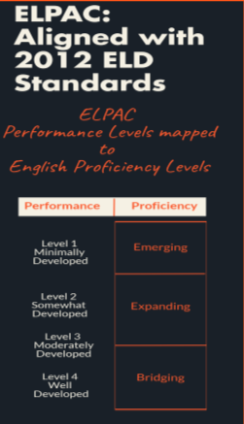
Practice Scoring
Transfer scores onto the summary sheet
Total the scores for an overall performance level in primary language and in English
Correlate performance to a proficiency level
If a student scores 80 in either language you should consider testing with ELPAC and providing accommodations

Slide 18
Now What???
Scores and levels included on IEP: Present Levels of Performance page and ELD page
Goals that involve language must be linguistically appropriate
Notes:
Based on the levels they receive for English and primary language
The IEP team will use the proficiency levels in terms of emerging, expanding, bridging when developing goals

Slide 19
IEP Team Recommendation for Reclassification
For students with disabilities, each district will develop a process for reclassification of students who are English Learners:
Compile a list of students who have not met the LEA overall reclassification criteria.
The IEP team meets and includes the district/site EL personnel and consults with parents.
Consider whether the disability is impacting performance
If the IEP team determines that the primary reason the student does not meet LEA reclassification criteria is due to the disability rather than limited English proficiency and the student no longer needs English learner services, they will recommend reclassification and send the information to the EL reclassification district representative.
Case manager and parent are notified, student is given an RFEP date and the next IEP will reflect the change in status.
Notes:
Joanna
Reclassification: defined as the process by which ELs are RFEP when they have demonstrated they can compete effectively with their English-speaking peers,
Assessment of language proficiency using an objective assessment (ELPAC )
Teacher evaluation, including but not limited to a review of the student’s mastery of the curriculum
Comparison of performance in basic skills
Parent opinion/consultation

Slide 20
Questions?

Slide 21
Resources
CDE website: 2018-2019 ELPAC Guide
English Language Proficiency Assessments for California (ELPAC)
Matrix 4
ELPAC accessibility graphic
Ventura County SELPA Website (www.vcselpa.org): Resources for Teachers and Staff/English Learners
Guidelines for Reclassification of English Learners with Disabilities, Ventura County SELPA (2018)
Ventura County Comprehensive Alternate Language Proficiency Survey (VCCALPS), Ventura County SELPA (2018)
Meeting the Needs of English Learners with Disabilities, Santa Barbara County SELPA (2017)
Preschool English Language Survey (PELS) for Preschoolers who are being initially assessed for SPED
Cathi Nye cnye@vcoe.org
Joanna V. Della Gatta jdellagatta@vcoe.org

