Slide 1
English learner series: Reclassification of English learners in special education
October 4, 2018
Joanna V. Della Gatta, Director
Yanka Ricklefs, director
Ventura county selpa

Slide 2
objectives
Who is involved?
When to consider recommending reclassification
Completing the worksheet for recommendation
Notes:
Yanka- this is what we will be covering for today

Slide 3
LEA Reclassification Criteria for all students
Reclassification: defined as the process by which ELs are RFEP when they have demonstrated they can compete effectively with their English-speaking peers, CBE/CDE per EC 313 (d)
Assessment of English language proficiency (ELP) using an objective assessment (including, but not limited to the state test ELPAC/CELDT) and
Teacher evaluation, including but not limited to a review of the student’s mastery of the curriculum and
Comparison of performance in basic skills based on the performance of English proficient students of the same age and
Parent opinion/consultation
CDE Letter dated 9_14_18 Reclass Guidance 18-19
Notes:
Yanka- this is reclassification for ALL students, regardless of general ed or special ed
CDE website Interim Reclass letter dated
https://www.cde.ca.gov/sp/el/rd/interimreclass1819.asp
It is anticipated that the final threshold scores will be presented to the SBE in November 2018, followed by proposed reclassification criteria in January 2019. After approval of these actions, an updated guidance letter will be provided to LEAs.
Because the threshold scores at this time are preliminary, LEAs may locally determine their own ELPAC threshold scores, in combination with the general performance level descriptors provided at https://www.cde.ca.gov/ta/tg/ep/elpacgpld.asp, for reclassification purposes until the SBE approves the final threshold scores in fall 2018, at which time the CDE will provide new reclassification guidance for the 2018–19 school year and beyond.

Slide 4
Reasons students with disabilities do not meet district requirements
English language proficiency (ELP) assessment
Do not meet minimum scores
Basic Skills comparison (SBAC or local assessments determined by LEA)
Do not meet proficiency on ELA
Classroom performance
Do not perform at grade level in curriculum based assessments
Notes:
Yanka

Slide 5
Why use alternate criteria?
Allows a team that knows the student to make the connection that the failure to meet the district reclassification criteria is a result of the disability, not
second language acquisition
Notes:
Yanka- alternate criteria is needed for our students who don’t meet the requirements mentioned in the prior slide.

Slide 6
When to discuss reclassification?
In preparation for an IEP meeting
At the IEP meeting- Ideally at an Annual Review or Triennial Review
May be done at Other Review or Addendum
Notes:
Yanka- needs to be discussed in the context of an IEP meeting

Slide 7
Who is involved in the process?
Parents
Site EL Teacher on Special Assignment (TOSA) or General Ed. ELD teacher or the Language Acquisition Team member, EL Coordinator
Case Manager, School Psychologist, Speech Language Pathologist
LEA Representative
Notes:
Yanka - districts may run this process differently depending on their own structure and procedures. Some schools have a LAT, others may not. You need to follow your district’s process.
A professional with training and expertise in second language acquisition who has an understanding of how to differentiate between the student’s limited ELP and the student’s disability should be part of the team for ELs with disabilities

Slide 8
How to get started?
1) Consult with EL Coordinator
2) Use Reclassification worksheet and look at the sources of data that you will need:
Past two years’ scores on CELDT/ELPAC or VCCALPS
If VCCALPS, performance in native language
Classroom-based assessments (CBMs, district assessments, functional skills data collection)
Most recent scores in ELA from CAASPP or local assessment of basic ELA skills
Performance in English at home and in community (use of English in home on phone, watching television and communication in the community)
Notes:
Yanka- Use score reporting information SAMPLE HO
do your homework ahead of time. Do you have the information to consider reclassification at this time? Do you have all of the information needed to assist in making that determination?
Seek information from parent about student performance in English at home and in community
Such as: use of English in home on phone, watching television and communication in community,

Slide 9
develop a process for reclassification
For students with disabilities, each district will:
Compile a list of students who have not met the LEA overall reclassification criteria.
The IEP team meets and includes the district/site EL personnel and consults with parents.
Consider whether the disability is impacting performance.
If the IEP team determines that the primary reason the student does not meet LEA reclassification criteria is due to the disability rather than limited English proficiency and the student no longer needs English learner services, they will recommend reclassification and send the information to the EL reclassification district representative.
Case manager and parent are notified, student is given an RFEP date and the next IEP will reflect the change in status.
Notes:
Yanka- you should be familiar, or become familiar, with your district’s process for reclassification.
Reclassification: defined as the process by which ELs are RFEP when they have demonstrated they can compete effectively with their English-speaking peers, CBE/CDE per EC 313 (d)
Assessment of language proficiency using an objective assessment (ELPAC/VCCALPS
Teacher evaluation, including but not limited to a review of the student’s mastery of the curriculum
Comparison of performance in basic skills
Parent opinion/consultation

Slide 10
Step 1- Who?
Compile a list of students with IEPs who have not met the overall reclassification criteria.
How would you go about this task?
Who has this information?
Notes:
Yanka
How would you locate this information? Who at the district has this information? How would you know if there are students on your caseload who are Els? What is the definitive source of EL status? Don’t go by the cover page of the IEP.

Slide 11
Step 2- Consult as a team
The stakeholders meet. Be sure to include the district/site EL personnel and consult with parents.
Notes:
Yanka- again, follow your district’s process for this.
The Language Acquisition Team. How does your site review progress for Els? Involve all stakeholders from the beginning. Consider how long the student has been an English Learner? Progress on CELDT? Current test scores? IEP progress? ELD instructional supports and strategies that have been tried.

Slide 12
Step 3- use reclassification worksheet
Consider whether the disability is impacting performance.
Use the CDE criteria for reclassification of all students with considerations for students with disabilities.
Notes:
Yanka
Worksheet

Slide 13
begin with your explanation of how the disability affects language acquisition
Notes:
Joanna

Slide 14
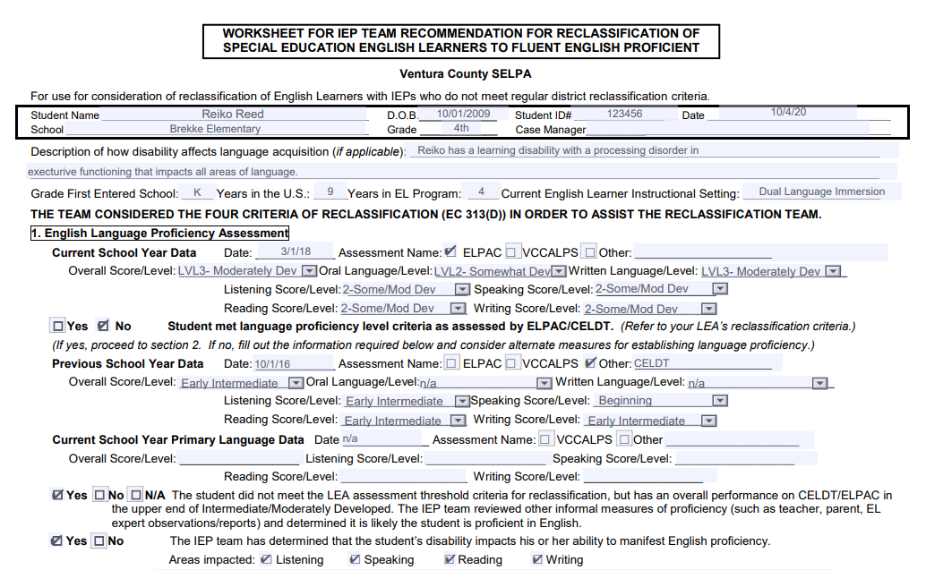
Classroom measures of performance
Show image of top part of page 2
Notes:
Joanna- use description from impact of disability box on PLOPS page and enter the data that is known about the student’s school program

Slide 15
Worksheet for IEP Team Recommendations for Reclassification
Assessment of English Language Proficiency: CELDT/ELPAC or alternate (VCCALPS). If the regular criteria are not met, IEP team considers the impact of the disability on the scores and determines whether the student demonstrates English Language Proficiency commensurate with abilities.
Possible indicators:
Student has similar academic deficits and error patterns in English as well as primary language
error patterns in listening, speaking, reading, and writing are typical of students with that disability versus students with developing second language
VCCALPS scores indicate overall proficiency level of Bridging
Notes:
Joanna
1) Indicators that the disability impacted the scores are that the student has similar error patterns in English and primary language, errors patterns are typical of student with that disability vs. students with second language issues, or VCCALPS have an overall proficiency level of EA or higher. If yes, the student demonstrated an appropriate level of Eng Lang proficiency commensurate with abilities.

Slide 16
1. English Language Proficiency Assessment
Enter most recent scores onto the worksheet
If the student DID NOT meet minimum scores in language proficiency, go to the second half of the section.
Notes:
Joanna

Slide 17
Performance on EL test
Show image of bottom half of page one
Notes:
Joanna

Slide 18
Alternate measures for establishing language proficiency
Enter last year’s scores
1
Enter native language scores if you have them (e.g., VCCALPS or Bateria Woodcock)
2
Indicate the reason student did not meet minimum scores on ELPAC/ CELDT or VCCALPS:
3
Other informal measures indicate they are “likely proficient” in English
Disability affects performance on tests
Check the bottom box “yes” and move to the next section
4
Notes:
Joanna

Slide 19
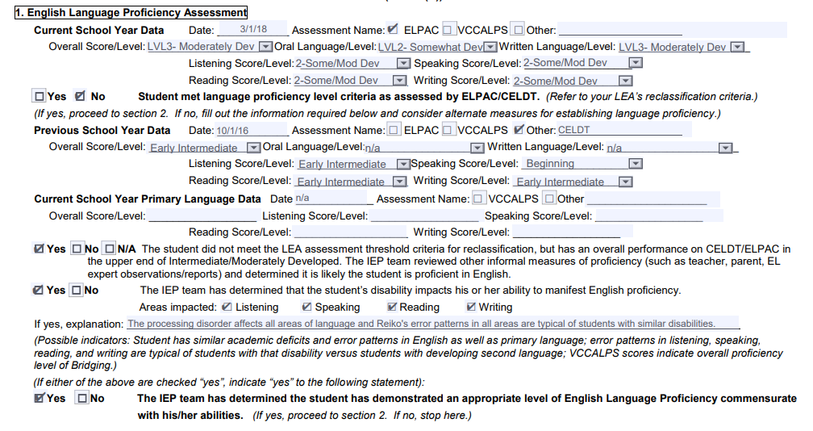
Performance on EL test
Show image of bottom half of page one
Notes:
Joanna

Slide 20
2. Teacher’s evaluation of academic performance
Review CBMs, district-wide assessment, formative assessment, progress on IEP goals.
Compare to peers with like disabilities. A disability may be a factor that contributes to low achievement and unrelated to English language proficiency.
If the regular criteria are not met, the IEP team considers the impact of the of the disability on academic performance and determines whether the student demonstrates a level commensurate with abilities, rather than acquisition of English.
Give rationale
Check the bottom “yes” box and move to the next section
Notes:
Joanna
Teacher evaluation: CBMs, district-wide assessment, formative assessment, progress on IEP goals. If the regular criteria are not met, the IEP team considers the impact of the of the disability on academic performance and determines whether the student demonstrates a level commensurate with abilities.
Curriculum based measures (CBM)
Progress towards IEP goals
Observations with peers in class
Classwork and homework samples
Comparison of progress and work to other peers with like disabilities

Slide 21
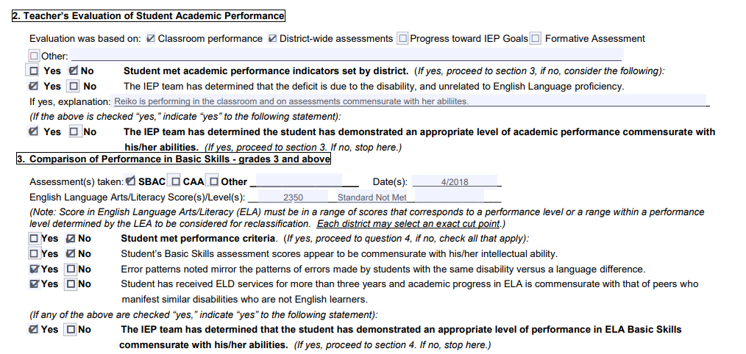
Top of form
Show graphic of top of form and what goes on it (demographics, etc?)
Notes:
Joanna

Slide 22
Worksheet for IEP Team Recommendations for Reclassification
Comparison of Basic Skills: SBAC, CAA, local assessments. If the regular criteria are not met, IEP team considers the impact of the disability on English/Language Arts/Literacy and determines whether the student demonstrates ELA basic skills commensurate with abilities.
Parent Opinion and Consultation: parent participation in the process and comments are noted
Recommendation: The IEP determines whether the primary reason the student does not meet reclassification criteria is due to the disability rather than limited English proficiency and the student no longer needs ELD services.
Notes:
Joanna
3) The IEP team considers whether the scores on the ELA assessment appear to be commensurate with the student’s intellectual ability, whether error patterns mirror the patterns of errors made by students with the same disability versus a language difference, and/or whether the student has received ELD services for more than 3 years and academic progress in ELA is commensurate with peers who manifest similar disabilities who are not English learners.

Slide 23
3. Comparison of performance in Basic Skills
Scores on SBAC or CAA- ELA
Make the case that the low performance in ELA is due to the disability, not the acquisition of English
Check the bottom box ”yes” and move on to the next section
Notes:
Joanna

Slide 24
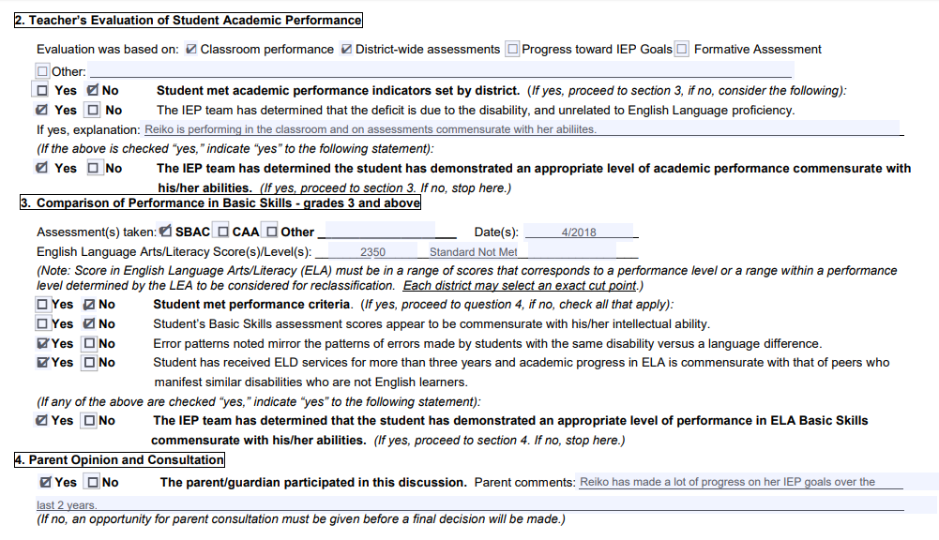
Notes:
Joanna

Slide 25
4. Parent Input
Parents must have input in the process, but don’t have to agree
Work with your EL TOSA/District Bilingual Director/EL Coordinator about what to do if parent is not in agreement
Document parent input
Notes:
Joanna

Slide 26
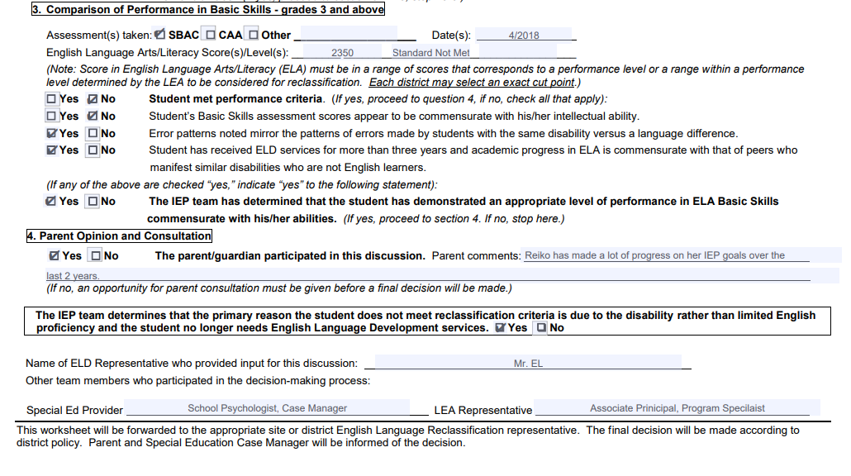
Top of form
Show graphic of top of form and what goes on it (demographics, etc?)
Notes:
Joanna

Slide 27
Team Determination
Check “yes” at the bottom of the page.
Enter in names of staff who participated in the process
Requires:
Special Ed Case Manager/School Psychologist
EL Expert
LEA Representative
Notes:
Joanna

Slide 28
Consultation by EL Specialist
Show bottom part of page 3
Notes:
Joanna

Slide 29
If the team agrees to Reclassify at the meeting
ELD page:
Put in scores at top as usual
Check the box: “The IEP Team agrees to recommend the student for reclassification…”
Keep the bottom half of the form BLANK
No Goal numbers or services
Present Levels page: Describe progress in reading, writing, communciation
Notes page: summarizes reclassification
SIS page: will say “EL”
Notes:
Joanna

Slide 30
Notes:
Joanna

Slide 31
Step 4- After the worksheet is complete
If the team determines that the primary reason the student does not meet reclassification criteria is due to the disability rather than limited English proficiency and the student no longer needs English learner services, they will recommend reclassification and send the information to the EL reclassification district representative.
Notes:
Joanna
District process varies

Slide 32
Step 5- reclassification
Case manager and parent are notified, student is given an RFEP date and the next IEP will reflect the change in status.
Notes:
Joanna
District process varies

Slide 33
Scenario
Jorge is an 8th grade student eligible for special education under specific learning disability. He is a highly verbal student who struggles in the areas of reading and writing due to a visual processing deficit. He functions at approximately the 7th grade level in math and the 4th-5th grade level for reading and writing. He was classified as an English Learner upon entering kindergarten. His ELPAC scores this year are:
Overall: Moderately Developed- Level 3
Oral Language: Moderately Developed- Level 3
Written Language: Somewhat Developed- Level 2
Listening: Moderately Developed
Speaking: Somewhat Developed
Reading: Minimally Developed
Writing: Beginning
Notes:
Yanka:

Slide 34
consider reclassification; Practice with a partner
Notes:
Regina
Practice and debrief

Slide 35
Questions
Is the reclassification worksheet used for Mild/Moderate AND Moderate/Severe students?
Who can reclassify?
What is the IEP team’s role in recommending reclassification?
Notes:
Regina

Slide 36
Resources
CDE website: Testing and Accountability & Specialized Programs
2016-2017 and 2017-2018 CELDT Information Guide
CDE Letter Interim Reclassification Guidance for 2017–18, dated January 2, 2018
Matrix Four (2017) for ELPAC
Ventura County SELPA Website (www.vcselpa.org): Resources for Teachers and Staff/English Learners
Guidelines for Reclassification of English Learners with Disabilities, Ventura County SELPA (2016)
Ventura County Comprehensive Alternate Language Proficiency Survey (VCCALPS), Ventura County SELPA (2018)
Meeting the Needs of English Learners with Disabilities, Santa Barbara County SELPA (2016)
Notes:
2018 Matrix 4 just released

