Slide 1
How Will My Child Participate in State Testing?
Joanna V. Della Gatta, Director, Technical Support and Transition
Ventura County SELPA
March 2022

Slide 2
What test(s) will my student take?
Smarter Balanced Assessment of California (SBAC) or California Alternate Assessment (CAA); Grades 3-8 and 11
English/Language Arts (Grades 3-8 and 11)
Math (Grades 3-8 and 11)
When: Each school selects its own testing window. Testing can begin as early as January and continue through the last day of school.
Science (Grades 5, 8 and once in high school)
When: Testing can begin as early as January and continue through the last day of school.
Science alternate: Teachers choose the best time to test students between September and the last day of school, based on when the concepts are taught.
English Language Proficiency Assessments of California (ELPAC) or Alternate ELPAC
CDE Parent Guides to Understanding State Testing

Slide 3
Grade | English Language Arts (SBAC or CAA) | Math (SBAC or CAA) | Science (CAST or CAA) | English Language Proficiency (ELPAC or Alternate ELPAC) for English Learners ONLY | Physical Fitness
K |  |  |  | X
1 |  |  |  | X
2 |  |  |  | X
3 | X | X |  | X
4 | X | X |  | X
5 | X | X | X | X | X
6 | X | X |  | X
7 | X | X |  | X | X
8 | X | X | X | X
9 |  |  |  | X | X
10 |  |  | District decision | X
11 | X | X | District decision | X
12 |  |  | District decision | X
Notes:
Locate the grade level of your student and identify which assessment they will take this year. All assessments are given in the Spring.

Slide 4
How will my child participate in state testing?
Notes:
Information can be found under the Families tab of the SELPA website.

Slide 5
The Smarter Balanced Summative Assessments
The Smarter Balanced Summative Assessments are part of the state testing system called the California Assessment of Student Performance and Progress or CAASPP.
The CAASPP System is designed to give information to teachers, students, and their families about what students know and are able to do and whether they are on track to be ready for success in college or career when they graduate from high school.
CDE Smarter Balanced Assessments (SBAC) Parent Guide
CDE Parent Guide California Science Test
Notes:
https://www.cde.ca.gov/ta/tg/ca/documents/sbsummativepgtu.pdf

Slide 6
The California Alternate Assessments for English Language Arts/Literacy (ELA), Mathematics, and Science
The California Alternate Assessments (CAAs) are part of the state testing program called the California Assessment of Student Performance and Progress, or CAASPP.
The CAAs are designed for students with significant cognitive disabilities. Students are eligible only if an alternate assessment is indicated in their active individualized education program (IEP) by the IEP team.
CDE California Alternate Assessments (CAA) Parent Guide

Slide 7
THE CALIFORNIA ALTERNATE ASSESSMENTS; The Decision To Participate “What is the right test for my child?”
This decision is made by the IEP team, based on data.
An IQ score alone does not determine a significant cognitive disability; rather, a holistic understanding of the student is required to make the determination.
Students identified with a specific learning disability cannot also be identified as cognitively impaired, as the determination of a specific learning disability rules out cognitive impairment.
Consider conceptual, social and practical skills.
The student is learning content derived from the Common core> the Core Content Connectors (CCCs).
The student needs extensive direct individualize instruction with substantial supports.
CDE- IEP Team guidance for alternate assessment

Slide 8
The English Language Proficiency Assessments for California (ELPAC)
The ELPAC is the test that is used to measure how well students in kindergarten through grade twelve understand English when it is not their primary language.
Information from the ELPAC helps your child’s teacher provide support in reading, writing, listening and speaking.
Initial ELPAC: within 30 days of when they first enroll in a California school
Summative ELPAC: every spring, between February and May, until they are reclassified as fluent English proficient
CDE- ELPAC PARENT GUIDE TO UNDERSTANDING

Slide 9
The English Language Proficiency Assessments for California (ELPAC)
As with the Alternate to the SBAC, if students have significant cognitive disabilities and are unable to participate in the ELPAC assessment with accommodations, they should take the Alternate ELPAC .
CDE- Alternate ELPAC PARENT GUIDE

Slide 10
Physical Fitness
A comprehensive fitness test
Grades 5, 7, 9
When Feb- May
CDE Parent Guide Physical Fitness Test
CDE Physical Fitness Test webpage

Slide 11
What Supports Will My Child Have For Testing?
Supports for testing should mirror supports in daily instruction and assessment.

Slide 12
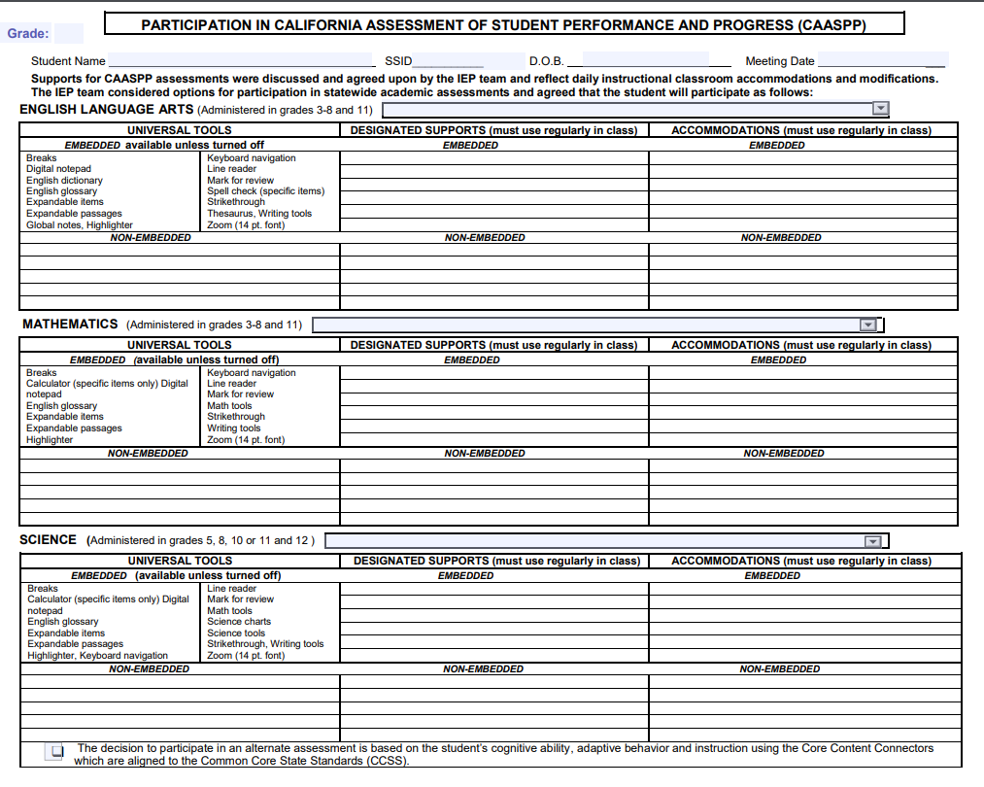

Slide 13
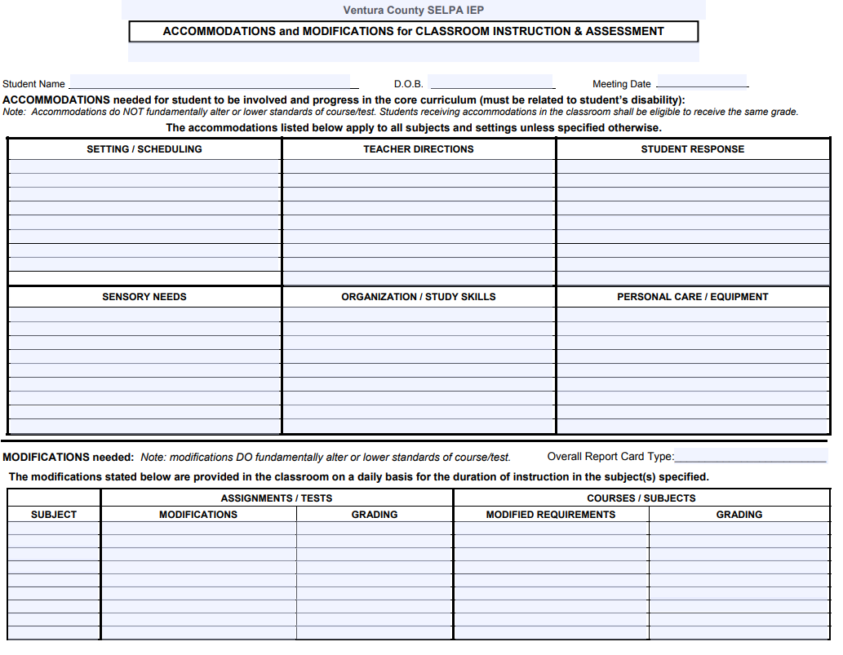

Slide 14
2021–22 California Student Assessment Accessibility Graphics
English Language Arts/Literacy(PDF)
Mathematics(PDF)
Science(PDF)
English Language Proficiency Assessments for California (ELPAC)
Computer-based(PDF)
Paper-Pencil(PDF)
Physical Fitness Accessibility

Slide 15
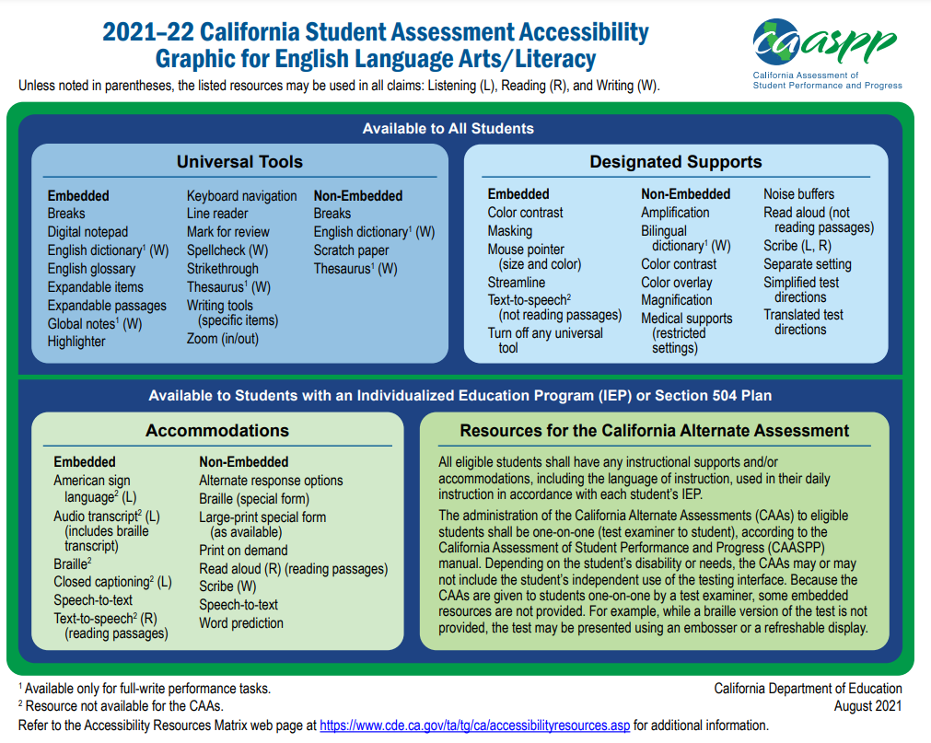
Notes:
https://www.cde.ca.gov/ta/tg/ca/documents/elaresources.pdf

Slide 16
Notes:
https://www.cde.ca.gov/ta/tg/ca/documents/mathresources.pdf

Slide 17
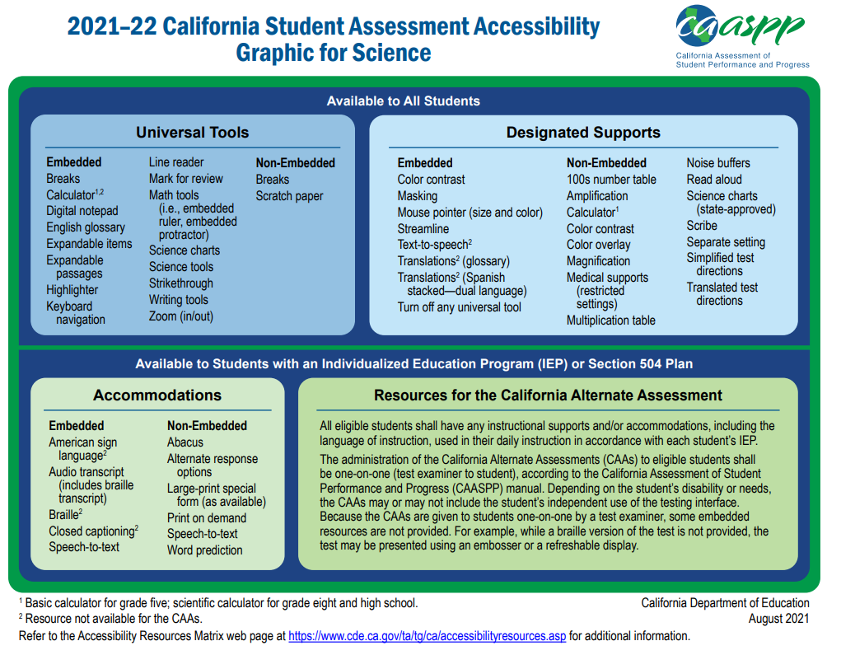
Notes:
https://www.cde.ca.gov/ta/tg/ca/documents/scienceresources.pdf

Slide 18
Notes:
These are the supports for the computer based ELPAC which is for all students (except for Kinder-2 for the writing domain). Supports listed are for all domains unless noted. https://www.cde.ca.gov/ta/tg/ca/documents/elpacresourcescb.pdf

Slide 19
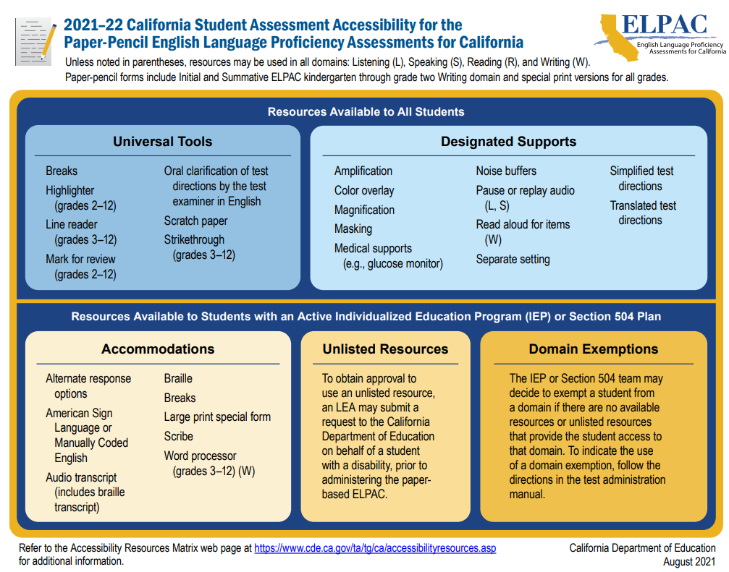
Notes:
The supports for the paper pencil assessment are for all domains unless noted. https://www.cde.ca.gov/ta/tg/ca/documents/elpacresourcespp.pdf
Students take the paper pencil assessment the first time they take the ELPAC (Initial ELPAC- for students first entering school in CA- within the first 30- days of enrollment) and for the Summative assessment grades Kinder-2 Writing domain only.

Slide 20
Physical Fitness Test
Do students with disabilities take the PFT?
Yes. Most of the fitness areas of the FITNESSGRAM® have two or three test options so all students, including those with disabilities, have the chance to participate in the PFT. Students are to be given as much of the test as their condition will permit.
Notes:
The supports for the paper pencil assessment are for all domains unless noted. https://www.cde.ca.gov/ta/tg/ca/documents/elpacresourcespp.pdf
Students take the paper pencil assessment the first time they take the ELPAC (Initial ELPAC- for students first entering school in CA- within the first 30- days of enrollment) and for the Summative assessment grades Kinder-2 Writing domain only.

Slide 21
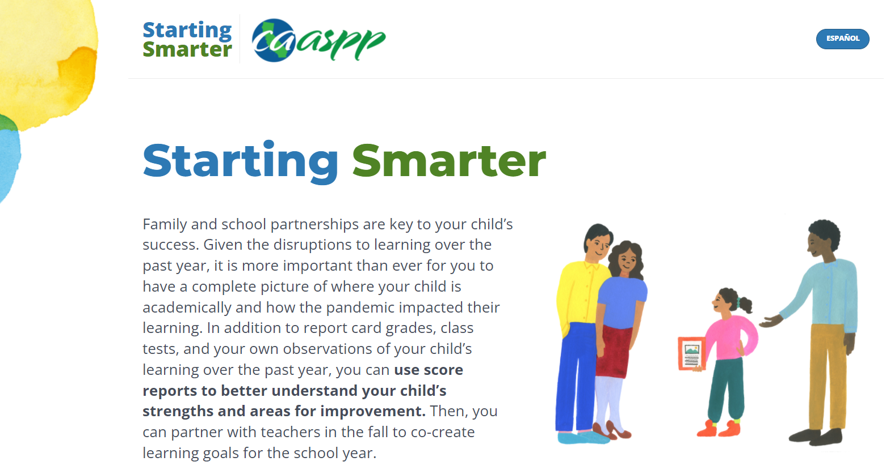
How can I help prepare my child?
Sample questions, as well as links to practice tests and resources, are available on the Starting Smarter web page at https://ca.startingsmarter.org .

Slide 22
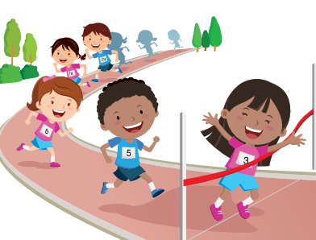
How can I help prepare my child for the physical fitness test?
Discuss the test with your child. Make sure your child is not scared or anxious.
Tell your child that you and the teacher have high expectations and are there to help, every step of the way.
Make sure your child engages in 60 minutes of activity every day.
Make sure your child gets a good night’s sleep and a nutritious breakfast before testing.
Review test results and help your child plan fitness activities to meet fitness goals.

Slide 23
Questions?

