Slide 1
English Learner Series: Linguistically Appropriate Goals
January 16, 2019
Joanna V. Della Gatta, Director, Transition And Technology
Yanka Ricklefs, Director, Personnel Development
www.vcselpa.org
Notes:
Yanka

Slide 2
Why is it important to talk about English Learners?
A Moral & Legal Obligation
Individuals with Disabilities Education Act 2004 (IDEA)
Preventing Disproportionality
In 2017-2018, English learners constituted 20% of all students in CA schools and English learners with disabilities 30% of students with disabilities.
In 2017-2018, English learners constituted 22% of all students in Ventura county and constituted 26% of all students with disabilities in Ventura County (12/1/17 CASEMIS).
Most “at-risk” learner subgroup
Notes:
Yanka

Slide 3
Education Code
EC 56345 (b) (2) For individuals whose native language is other than English, linguistically appropriate goals, objectives, programs, and services.
Notes:
Yanka: The IEP must include linguistically appropriate goals for students whose native language is other than English

Slide 4
California Code of Regulations
The IEP team must consider the language needs of the student as those needs relate to the student’s IEP. Specifically, the IEP must include “linguistically appropriate goals, objectives, programs and services”.
Notes:
Yanka

Slide 5
California Code of Regulations Title 5, Section §3001 (m) “Linguistically appropriate goals, objectives, and programs” means:
(1)(A) those activities which lead to the development of English language proficiency; and
(1)(B)Those instructional systems which lead to the language development needs of English language learners. (m)(2) For individuals whose primary language is other than English, and whose potential for learning a second language, as determined by the IEP team, is severely limited, the IEP team may determine that instruction may be provided through an alternate program, including a program provided in the individual’s primary language. The IEP team must periodically, but not less than annually, reconsider the individual’s ability to receive instruction in the English language
Notes:
Yanka
So… what does linguistically appropriate goals mean? It means how you instruct the students and the content you teach them.

Slide 6
Legal requirements for preschoolers
Even though it is not a legal requirement to formally identify a preschool age student as an English Learner in California, federal regulations state IEP team must follow bilingual assessment protocol to determine the language of preference of the student if the parent indicates that a language other than English is spoken at home and assess according to second language learner requirements (EC 56440 and 56441.11).
For purposes of IDEA’s requirement to write IEPs that meet the language needs of the student, IEP teams must ensure that their IEPs are linguistically appropriate.
This is not a formal EL identification that is entered in the LEA/district student database.
Notes:
Yanka- it is important to assess incoming preschoolers who are English Learners. We administer the PELs, which is only done once. When the student enters kinder, they are then given the ELPAC as an initial assessment and EL status is determined.
there is no legal requirement to formally identify preschool students as English learners, as there is no assessment process designated for this purpose in the State of California;
however, the IEP team must follow bilingual assessment protocol to determine the language of preference of the student if the parent indicates that a language other than English is spoken at home and assess according to second language learner requirements. EC 56440 and 56441.11

Slide 7
What Does this Mean??
As a comprehensive approach to ELD, the English Language Arts/English Language Development (ELA/ELD) Framework for California Public Schools states:
English learners at all English proficiency levels and at all ages require both integrated ELD and specialized attention to their particular language learning needs, or designated ELD. (p. 119)
Notes:
Joanna

Slide 8
DUAL OBLIGATION for Services
OBLIGATION #1 Designated ELD
Protected time during the regular school day where qualified teachers work with English learners grouped by similar proficiency levels
Main Focus:
Student production of language (Speaking and Writing) using the CA ELD Standards
Notes:
Joanna- Designated ELD is NOT RTI or an intervention. Designated ELD is required. This is for hugh need on production of languagi

Slide 9
DUAL OBLIGATION for Services
OBLIGATION #2 Integrated ELD
Provide meaningful access to ALL grade-level CCSS academic content through research-based strategies and techniques (SDAIE) used in tandem with ELD Standards
Main Focus:
Accessing & mastering content standards across all disciplines while using ELD standards to amplifying/highlight the key language knowledge and skills needed for ELs to succeed
Notes:
Joanna- accessing the content. They may not have the academic skills yet but may have good speaking skills in every day language.

Slide 10
A Comprehensive Program for English Learners
Designated ELD Instruction
Language
Content
Integrated ELD Instruction
Language
Content
Notes:
Joanna
What does this look like in the classroom?
Some confusion came with the new ELD standards… we want to be clear that EL students are guaranteed both designated and integrated minutes everyday
School visitation: ELD time - Rainy day, assembly schedule, minimum days, etc… we can’t expect students to miraculously speak English when it rains or on min. days! We don’t cut math or ELA… we understand something needs to give, but lessons should be adjusted so that language is the focus during ELD. Content standards can provide the context, but the lesson should be “language or ELD forward”
If the student is more on the language side, keep that in mind when you start developing goals, vs the EL student who is older and has the basic language but now needs to work on content.

Slide 11
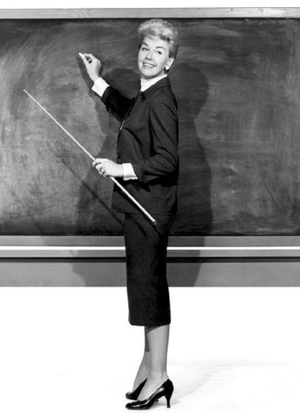
ELD Standards
Language acquisition is treated as a non-linear linguistic and social process
Asset vs. deficit approach literacy foundational skills target varying profiles of ELs, tapping linguistic resources
Focus on teaching academic English
Notes:
Joanna

Slide 12
ELD Standards
Three Critical Principles for Developing Language and Cognition in Academic Contexts
Interacting in meaningful ways
Learning about how English works
Using foundational literacy skills
Notes:
Joanna

Slide 13
What about students who took an alternate to the ELPAC- the VCCALPS?
Use the VCCALPS performance levels to assist with determining relative areas of need.
Scoring on the VCCALPS has been aligned to the ELPAC.

Slide 14
Preschool Goals
Foundations in English Language Development:
Listening
Speaking
Reading
Writing
Notes:
Joanna
These 4 categories are aligned with the 4 tests in the PELS (Preschool English Language Survey).

Slide 15
Correlations
Mode of Communication Common Core Domain
Listening + Speaking Collaborative
Reading + Listening Interpretive
Speaking + Writing Productive
ELPAC Performance Level EL Proficiency Level
Minimally Developed Emerging
Somewhat/Moderately Developed Expanding
Well Developed Bridging
Notes:
Correlating the modes of communication to the domains of language in the standards and the performance levels on ELPAC to proficiency levels

Slide 16
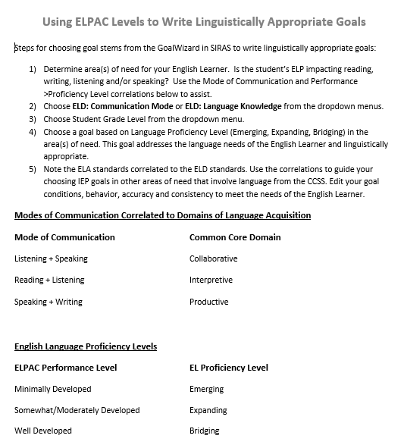
Resource for the IEP Team
Using the ELPAC levels to help write linguistically appropriate goals
Notes:
Joanna
Handout- instructions for writing developmentally linguistically appropriate goals

Slide 17
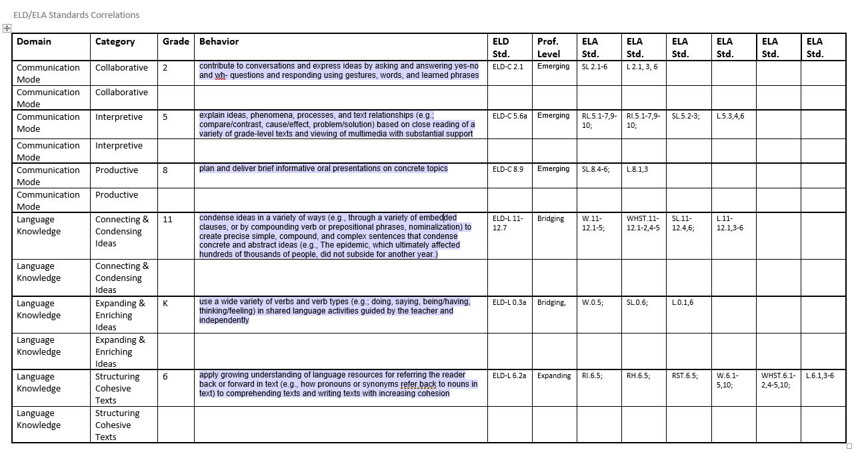
ELD/ELA Correlations Activity
Work in groups of 2-3
Refer to graphic organizer
Using SIRAS GoalWizard or your IEP Goals resources
Notes:
Joanna- handout- I will demo communication mode- collaborative- grade 2 student. ELD-C 2.1
We are going to work together to see how the ELD standards correlate to CC standards
In SIRAS, locate the ELD standards. Note where the ELA standard numbers are found (standard column)
Clear out your search
Locate the ELA standards
Select the ELA standard that best correlates to the ELD standard. Write that ELA standard on the graphic organizer.

Slide 18
How might an EL expert assist with developing linguistically appropriate goals?
Notes:
Joanna
The EL expert might know better how the student is communicating
Talk to your EL coordinator, content specialist

Slide 19
Present Levels of Performance
Scores/levels for ELPAC/VCCALPS
Summary of progress in language proficiency in Reading and Writing areas and Listening and speaking in the Communication area
Note: For preschoolers, English Proficiency level determined from the Preschool English Learner Survey (PELS) is noted on the Preschool Strategies page.
Notes:
Joanna: a narrative on language proficiency levels in the communication sections. The scores are not enough. Other Language proficiency assessment

Slide 20
Present Levels of Performance
Academics Reading/Writing:
Made progress (moved from beginning to moderately developed on the ELPAC), expanding in English Language Proficiency.
Communication:
Uses both English and Spanish in the classroom and playground
Struggles with understanding academic English
Uses Mixteco with peers
Communicates with parents in Hmong but uses English conversationally at school
Proficient in basic interpersonal communication skills (conversational) skills
Beginning to develop cognitive academic language proficiency
Notes:
Joanna

Slide 21
Three things to consider when addressing language needs
Language proficiency
Level of functioning
Student’s disability
J. Butterfield, 2016
Notes:
Joanna

Slide 22
IEP Goals
State present levels: strengths and weaknesses
Include assessment results (English and Native Language performance and proficiency)
Determine areas of need
Notes:
Joanna
We need to know the student’s EL acquisition level compared to their peers and the courses they are taking- need to consider those when developing goals.

Slide 23
Linguistically Appropriate Goals
Aligned to students’ current language proficiency level
Aligned to California ELD standards in listening, speaking reading or writing
Drafted to account for student’s language ability
J. Butterfield, 2016
Notes:
Joanna

Slide 24
Goals
Goal
Goal(s) drafted address need(s) in the area(s) of English Language Proficiency (Reading, Writing, Listening, Speaking)
Correlate
Correlate to assessment results (ELPAC/ VCCALPS/PELS) and present levels
Goal
Goal(s) in the area of language most likely will be in literacy or communication
Select
Select from the ELD standards in the GoalWizard
Use
Use the ELA correlation to guide the choice of goals that involve language and which will lead to linguistically appropriate goals
Notes:
Joanna
ELD standards are correlated to ELA standards and indicate the grade range and ELD levels for each behavior/skill. A student may often score below somewhat developed in more than one area on the ELPAC (or other), however, select the area(s) that are impacting performance the most, and not the result of the disability. (i.e., listening for DHH).
The standards for ELs in preschool are from the Preschool Foundations

Slide 25
Constructing a Goal
6 grader
Reading: Somewhat Developed
Listening: Moderately Developed
Speaking: Moderately Developed
Writing: Somewhat Developed
Notes:
Reading, writing and listening are all at the emerging level.
For this student, the areas of need on the IEP are reading and writing (written language
ELD standards under interpretive or productive - reading and writing specifically-if student needs a reading or writing goal, go to the EL standards in SIRAS under the interpretive domain and look for information on conversation skills or Language Knowledge domain/ connecting and condensing ideas or expanding and enriching ideas. The CCSS Speaking/Listening standard alone does not really accommodate for the student’s EL proficiency level. The broken down speaking/listening standards in SIRAS take into account the disability but aren’t necessarily linguistically appropriate.
The speech and language specialists may have broken down the same speaking/listening standard with speech criteria in mind, but may or may not be linguistically appropriate for an EL.
Bottom line: if you have a need to write a communication goal, you wouldn’t necessarily go to the speech or the CCSS speaking listening first; go to the ELD standards/collaborative or Language knowledge in SIRAS.

Slide 26
How might an EL expert assist with developing linguistically appropriate goals?
Notes:
Joanna
The EL expert might know better how the student is communicating
Talk to your EL coordinator, content specialist

Slide 27
Selecting Goals for English Learners
Domain- ELD Communication Mode or Language Knowledge
Category- Collaborative, Interpretive, Productive, Connecting & Condensing Ideas, Expanding & Enriching Ideas, Structuring Cohesive Texts
Grade level
ELD Proficiency- Emerging, Expanding, Bridging
ELA Correlations
Notes:
Review slide Show EL Goal Bank (or Preschool EL goal bank) in SIRAS-collaborative standards based upon the 6 grader scores in prior slide. Look at the ELD standards and discuss which ones are appropriate for the student’s need. Model how to select goals using the Wizard. Review a sample student from scores to goals choice.

Slide 28
Goals for English Language Development
Area of Need- Reading, Writing, Communication
For goals that involve language
Responsible discipline- tied to location of service on ELD page
Reason for goal- tied to need from ELPAC/VCCALPS/PELS scores and present levels
Language of instruction
All language goals must be linguistically appropriate
Notes:
Review slide Show example of Goals page in SIRAS.

Slide 29
Practice: Draft a Goal
Choose a student who is an English Learner
Review current Present levels page and test scores
What kind of a goal should you develop?
Notes:
Where do you start?
What resources do you have?

Slide 30
Questions?

Slide 32
Resources
Ventura County SELPA: www.vcselpa.org
ELD Standards: https://www.cde.ca.gov/sp/el/er/eldstandards.asp

