Slide 1
English Learner Series: Pre-referral Strategies for English Learners Prior to Assessment for Special Education
February 26, 2018
Regina Reed, director of personnel development, VC SELPA
Joanna V. della gatta, director of technical support and transition, vc selpa
Echo Lee, ELD/Dual Language Content Specialist , vcoe

Slide 2
High Quality Instruction for English Learners
“It is fully expected that all English learners will receive high quality CCSS-based instruction as well as ELD standards-based instruction”
California ELD Standards, 2012 (Appendix D (p.4))
as cited in ELITE 2016-VCOE Curriculum and Instruction
Notes:
Joanna- all ELs need SDAIE plus primary language support plus EL services until they are reclassified.

Slide 3
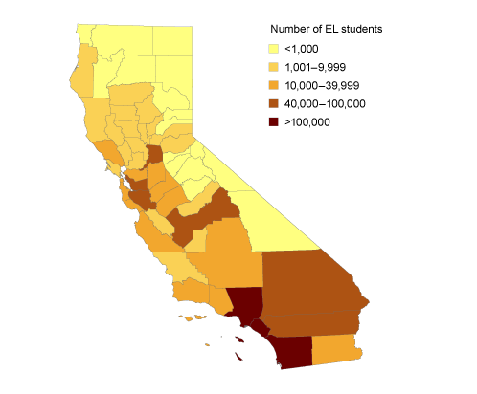
EL Data
County: 33,195 English Learners out of 139,104 total (23.9%)
State: 1.32M English Learners out of 6.2M students total (21.4%)
County: 3,904 ELs have a special education eligibility (26.9%)
State: 210,517 Els have a special education eligibility (31%)
Notes:
Joanna-our county has higher percentage of Els than state average, but we have fewer ELs with disabilities than the state average.

Slide 4
Food for Thought…
Who are Your English Learners?
Is it possible they are solely EL?
Is it possible they only need special education services?
Is it possible these students are neither EL nor Special ed?
Who are the students classified as EL who are also in special education?
What does a disability look like?
What does difficulty with language acquisition look like?
What kinds of services do the students need to be successful?
Notes:
Regina-Turn and talk- who are your EL students? What do you already know about them? What would a language acquisition issue look like as opposed to a learning disability?

Slide 5
There are three categories of English learners who may experience academic difficulties:
1) Those with deficiencies in their teaching or learning environment; lack of effective ELD instruction and support
2) Those experiencing academic difficulties not related to a learning disability; interrupted schooling, limited formal education, medical problems, low attendance, high transiency or other factors
3) ELs that truly have a disability and are in need of special education (Artiles & Ortiz, 2002; Saunders, Goldenberg, & Marcelletti, 2013).
Notes:
Regina-From Jarice’s book

Slide 6
Research-based, intensive early intervention services for ELs with disabilities can minimize their being at risk for later school failure.
Early intervention means that "supplementary instructional services are provided early in students' schooling, and that they are intense enough to bring at-risk students quickly to a level at which they can profit from high-quality classroom instruction" (Madden, Slavin, Karweit, Dolan, & Wasik, 1991).
Provision of intervention services above and beyond the “core” to include English language development (ELD) services may be what many ELs require to be successful.
Notes:
Regina- students who are English learners AND who already have an established disability should be given access to interventions. Under MTSS, we are promoting the message that ALL students, even those with disabilities, should be provided intervention to assist them and help prevent further academic loss as they progress through their school years.
Today we will be looking at how we can support our English learners prior to making a referral to special education.

Slide 7
When an EL student is struggling academically:
Analyze the School Environment. Determine if appropriate curriculum and instruction for Els are being implemented.
1
Determine if prereferral interventions (RtI/MTSS) in areas of weakness have been implemented and documented over time, to include progress monitoring outcomes
2
Refer to Special Education. Assess in native language and English and other best practices for bilingual assessment to rule out language difference versus disability.
3
Notes:
Joanna
As a reminder- these are thing that might need to be looked at within your school setting. Are you or your teachers providing these supports?

Slide 8
PROVIDING ENGLISH LEARNERS WITH A LANGUAGE ASSISTANCE PROGRAM
• EL services and programs must be educationally sound in theory and effective in practice.
• EL programs must be designed to enable ELs to attain both English proficiency and parity of participation in the standard instructional program within a reasonable length of time.
• LEAs must offer EL services and programs until ELs are proficient in English and can participate meaningfully in educational programs without EL support.
•LEAs must provide appropriate special education services to ELs with disabilities who are found to be eligible for special education and related services.
English Learner Tool Kit OELA 2017
Notes:
Echo-
https://ncela.ed.gov/files/english_learner_toolkit/OELA_2017_ELsToolkit_508C.pdf
Office of English Language Acquisition

Slide 9
General Education Practices and Interventions
Notes:
Regina

Slide 10
More food for thought
Is an EL student’s academic difficulty due to a learning disorder or limited English proficiency?
Notes:
Regina- so how do we determine if an English leaner is struggling because of language issues or because of a disability?

Slide 11
Pre-referral Considerations for ELs
EC 56303. A pupil shall be referred for special educational instruction and services only after the resources of the regular education program have been considered and, where appropriate, utilized.
5 CCR 3030 ….(i) Data that demonstrate that prior to, or as a part of, the referral process, the pupil was provided appropriate instruction in regular education settings, delivered by qualified personnel;
Notes:
Regina
This is what ed code and CCR say

Slide 12
Integrated and Designated ELD: Both not Or
Integrated ELD
Provide meaningful access to ALL grade-level CCSS academic content through research-based strategies and techniques (SDAIE) used in tandem with ELD Standards
Main Focus:
Accessing & mastering content standards across all disciplines while using ELD standards to amplifying/highlight the key language knowledge and skills needed for ELs to succeed
Notes:
Joanna- Designated ELD is NOT RTI or an intervention. Designated ELD is required. This is for hugh need on production of languagi

Slide 13
Designated ELD
Protected time during the regular school day where qualified teachers work with English learners grouped by similar proficiency levels
Main Focus:
Student production of language (Speaking and Writing) using the CA ELD Standards
Integrated and Designated ELD: Both not Or
Notes:
Joanna- Designated ELD is NOT RTI or an intervention. Designated ELD is required. This is for hugh need on production of languagi

Slide 14
A Comprehensive Program for English Learners
Designated ELD Instruction
Integrated ELD Instruction
Content
Language
Language
Content
ELD standards driving
Content standards driving
Notes:
Joanna
What does this look like in the classroom?
Some confusion came with the new ELD standards… we want to be clear that EL students are guaranteed both designated and integrated minutes everyday
School visitation: ELD time - Rainy day, assembly schedule, minimum days, etc… we can’t expect students to miraculously speak English when it rains or on min. days! We don’t cut math or ELA… we understand something needs to give, but lessons should be adjusted so that language is the focus during ELD. Content standards can provide the context, but the lesson should be “language or ELD forward”
If the student is more on the language side, keep that in mind when you start developing goals, vs the EL student who is older and has the basic language but now needs to work on content.

Slide 15
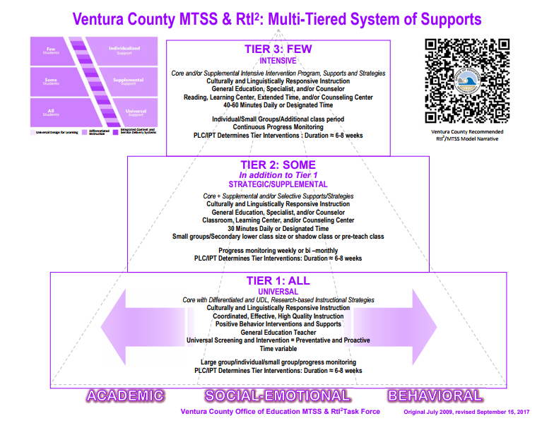
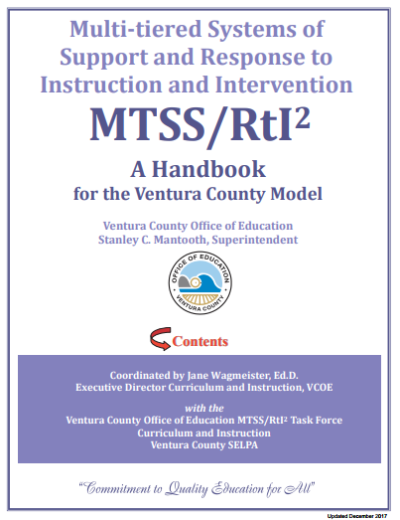
Ventura County MTSS/RtI²
Notes:
Joanna: The Ventura County Research-Based Model (preschool through Grade 12) was developed in 2007 in response to the needs of our educational community with the belief that ALL children and youth can learn. The model is a three-tiered approach to instruction and intervention that includes core, strategic/targeted, and intensive instruction to support the academic as well as the social, emotional and behavioral needs of students….
These models/processes are for all student including Els.

Slide 16
Research states:
ELLs without learning difficulties or (mild learning disabilities) have been shown to demonstrate gains in phonemic awareness and phonics skills when provided systematic tier 2 instruction in foundational literacy skills (Vaughn et al., 2006)
Students who are ELLs require ongoing and sustained instruction in English language, ELD, as part of the core areas for as long as possible (Dixon, Zhao, & Shin, 2012)
Notes:
Joanna

Slide 17
Considerations for selecting interventions for English Learners
The student’s language proficiency in their native (L1) and second language (L2) across all domains
The linguistic demands of the literacy intervention
Availability of native language support
For Designated ELD, students should be grouped with students with similar proficiency levels.
For targeted interventions, English learners “may benefit from being grouped with peers with similar learning needs.”
Notes:
Regina
Coffee & Ray-Subramanian, 2010, p.34 as cited in Olvera & Villapudua, 2014, Butterfield, Read 2016

Slide 18
Critical Pre-Referral Information for SSTs
Key Elements:
Background Information (e.g. years in U.S, instructional program, language of instruction, gaps in instruction)
Student Characteristics (e.g. LI/L2 proficiency, immigration pattern, economic circumstances, cultural interactions)
Classroom Instruction (e.g. Appropriate, Qualified Personnel, Differentiation, Designated ELD & Integrated ELD)
Response to Intervention (e.g. Tier 1, Tier 2)
Notes:
Regina
Native language Proficiency assessed by language appraisal team, looks different in each district and based on the stage of the referral process
Refer to most updated VCOE RTI Student Review Form A http://www.vcoe.org/Portals/7/Curriculum-Instruction/Documents/RtI/Form%20A%201.17.2017.pdf
Handout
Brown & Doolittle, 2008 as cited in Butterfield, 2014

Slide 19
Notes:
Regina

Slide 20
Are typical patterns in the language acquisition process being displayed?
Preproduction (3 months) – silent period
Early production (3-6 m)-using 1-3 words
Speech emergence (6m-2y)- simple sentences
Intermediate fluency (2-3y)- better comprehension, BICS
Interference, Inter-language, Silent Period, Code Switching, Language Loss, Language Difference
Ochoa, et al., 2005
Notes:
Echo
As the EL is acquiring BICS and CALP which can be a long process 10-12 years
At each language acquisition stage the student will display particular characteristics. The key question, that the SST is trying to tease out is the child’s learning struggles are due to the normal processes of 2nd lang. acquisition and the typical errors we would expect.
Interference: communicative behavior from one language are transferred over: “toma una silla” “take a seat” instead of “have a set”
Code switching: using two different language in the same sentence.
Adjective come after nouns- The house green, Past tense ed is often ommited: We walk yesterday
Superiority is demonstrated by using “mas”. This car is more big.
(Handout )Reference Butterfield’s Handout- Comparison of Language Differences Versus Disability. – we are going to do this reference a bit later

Slide 21
Language Acquisition
ELA Proficiency
Explicit, Specific, Deliberate Instruction and Curriculum
rich in Academic language
and Content vocabulary
CALP
Context reduced
Academic Language
Bridging
Advanced
Early Advanced
Language Plateau
Expanding
Intermediate
Emerging
Early Intermediate
Beginning
BICS
Context embedded
Survival English
Created by Armando Zuniga
Notes:
Echo: We know that many students especially those who might become LTEL, they hit a language plateau or get stuck at a CELDT level 3…why? What can we do?
Basic Interpersonal Communication Skills
Experts such as Jim Cummins differentiate between social and academic language acquisition. Basic Interpersonal Communication Skills (BICS) are language skills needed in social situations. It is the day-to-day language needed to interact socially with other people. English language learners (ELLs) employ BIC skills when they are on the playground, in the lunch room, on the school bus, at parties, playing sports and talking on the telephone. Social interactions are usually context embedded. They occur in a meaningful social context. They are not very demanding cognitively. The language required is not specialized. These language skills usually develop within six months to two years after arrival in the U.S.
Problems arise when teachers and administrators think that a child is proficient in a language when they demonstrate good social English.
Cognitive Academic Language Proficiency
CALP refers to formal academic learning. This includes listening, speaking, reading, and writing about subject area content material. This level of language learning is essential for students to succeed in school. Students need time and support to become proficient in academic areas. This usually takes from five to seven years. Recent research (Thomas & Collier, 1995) has shown that if a child has no prior schooling or has no support in native language development, it may take seven to ten years for ELLs to catch up to their peers.
Academic language acquisition isn't just the understanding of content area vocabulary. It includes skills such as comparing, classifying, synthesizing, evaluating, and inferring. Academic language tasks are context reduced. Information is read from a textbook or presented by the teacher. As a student gets older the context of academic tasks becomes more and more reduced.
The language also becomes more cognitively demanding. New ideas, concepts and language are presented to the students at the same time.
Jim Cummins also advances the theory that there is a common underlying proficiency (CUP) between two languages. Skills, ideas and concepts students learn in their first language will be transferred to the second language.

Slide 22
Are the language indicators the student displays possibly due to a language difference due to:
THE 2nd language acquisition PROCESS
OR
a possible disability?
http://www.sbcselpa.org/wp-content/uploads/2014/03/ELL-Vs-Learning-Disability-Chart-copy.pdf
Notes:
Joanna-Provide copies of the handout. Review the chart and the implications. Also look at the typologies chart. Look at 2 students. We are going to determine if they are exhibiting a language acquisition or learning disability.
Read 1-2 examples

Slide 23
Student 1: language acquisition or learning disability???
In U.S. three years or less Little or no English language proficiency Limited proficiency in native language Steady progress through language acquisition process Facing cultural transition
Little to no comprehension in L1 or L2
Needs clarification in L1 and L2
Student consistently takes a longer time period to respond in L1 & L2 and it does not change over time
Parent reports student forgets what is asked of him/her
Notes:
Joanna- use the chart to determine if this is language acquisition or learning disability. Work in small groups. Share out
This student will end up having a learning disability

Slide 24
Student 2: language acquisition or learning disability???
In U.S. 7+ years
Usually orally fluent in english
Reading/writing below level of native english peers
Academically bi-modal
Some literacy in primary language
May have been in bilingual program
Student demonstrates lack of motivation
Mainstream class – no longer receiving designated ELD but not yet reclassified
May not understand rigorous and academic tasks/instructions
Communicates with peers in english
Reads fluently but limited comprehension
Notes:
Joanna- this is a description of an LTEL, or long-tern Eng leaner. They have made progress but it has stalled. Progress not due to memory or processing deficit.
use the chart o previous slide and this information to determine if this is a learning issue or language issue. Work in small groups. Share out

Slide 25
Key principles for English Learner instruction
Opportunities to engage in discipline-specific practices, which are designed to build conceptual understanding and language competence together.
Teachers intentionally design learning opportunities that integrate reading, writing, speaking, and listening with the practices of each discipline.
Leverages ELs’ home language(s), cultural assets, and prior knowledge.
ELs’ home language(s) and culture(s) are regarded as assets and are used by the teacher in bridging prior knowledge to new knowledge, and in making content meaningful and comprehensible.
Standards-aligned instruction for ELs is rigorous, grade-level appropriate, and provides deliberate and appropriate scaffolds.
Teachers provide students with opportunities to describe their reasoning, share explanations, make conjectures, justify conclusions, argue from evidence, and negotiate meaning from complex texts.
Notes:
Echo-Moves ELs forward by taking into account their English proficiency level(s) and prior schooling experiences. Els within a single classroom can be heterogeneous in terms of home language(s) proficiency, proficiency in English, literacy levels in English and student’s home language(s), previous experiences in schools, and time in the U.S. Teachers must be attentive to these differences and design instruction accordingly.
Fosters ELs’ autonomy by equipping them with the strategies necessary to comprehend and use language in a variety of academic settings. Els must learn to use a broad repertoire of strategies to construct meaning from academic talk and complex text, to participate in academic discussions, and to express themselves in writing across a variety of academic situations. Tasks must be designed to ultimately foster student independence.
Diagnostic tools and formative assessment practices are employed to measure students’ content knowledge, academic language competence, and participation in disciplinary practices. These assessment practices allow teachers to monitor students’ learning so that they may adjust instruction accordingly, provide students with timely and useful feedback, and encourage students to reflect on their own thinking and learning.
LEAs must limit the segregation of ELs to the extent necessary to reach the stated goals of an educationally sound and effective program.

Slide 26
Instructional Essentials for Teachers
of English Learners
Provide comprehensible access to the content
Support oral language development
Explicitly teach academic English
Value cultural diversity
Notes:
Echo

Slide 27
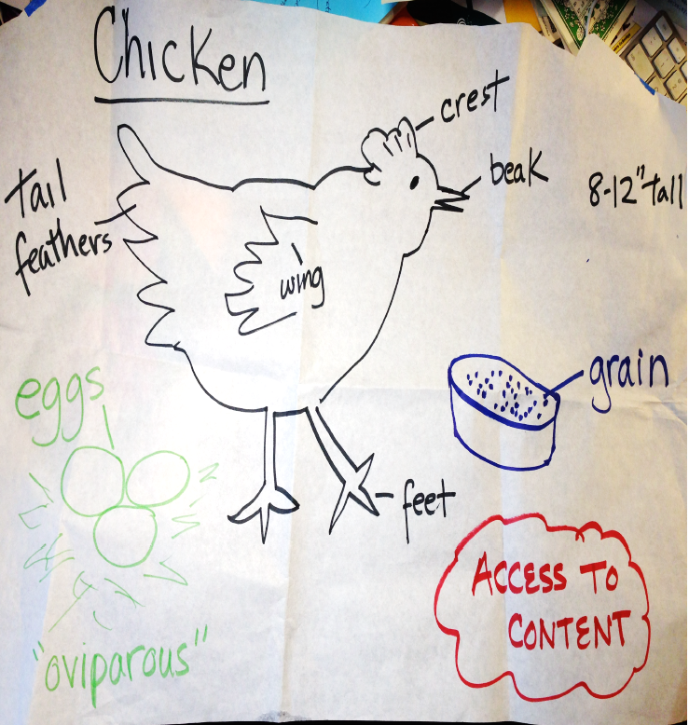
Access to the Content
Visuals
Labels
Home language support
Hands-on activities
Realia
Notes:
Echo:What is the teacher doing, and how does the environment make the content comprehensible? How is English Learners’ language being scaffold and how are the students supported to participate in activities. How are ELs being explicitly taught how English works, and given opportunities to practice and apply this knowledge

Slide 28
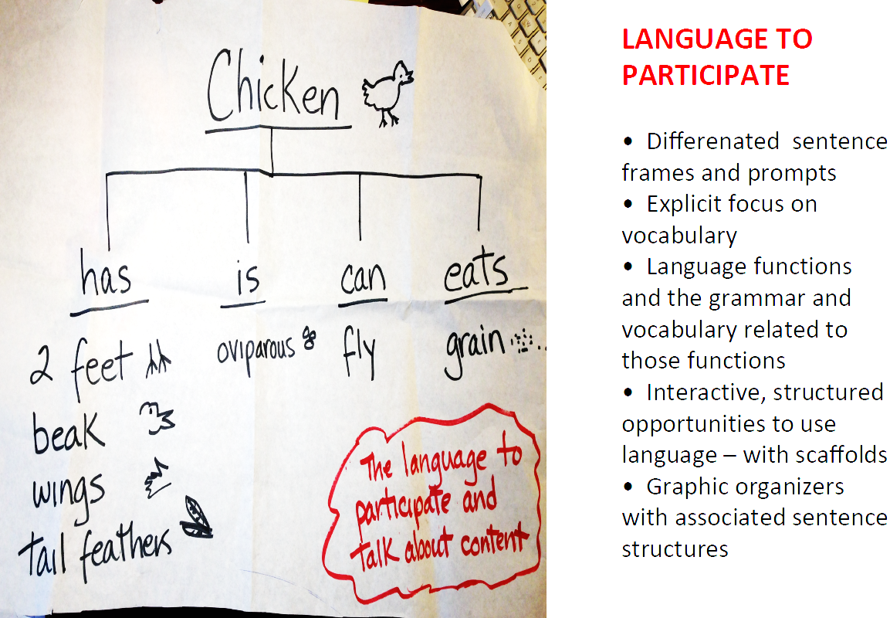
Language To Participate
Differentiated sentence frames and prompts
Explicit focus on vocabulary
Language functions and the grammar and vocabulary related to those functions
Interactive, structured opportunities to use language with scaffolds
Graphic organizers with sentence structures
Notes:
Echo

Slide 29
How English Works
Grammar
Text Structures
Expand and enrich expressions
Contrast analysis
Oral practice
Notes:
Echo

Slide 30
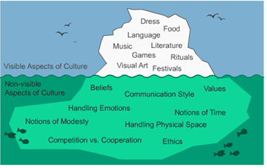
Culturally responsive teaching:
Recognizes the importance of including students' cultural references in all aspects of learning
Enriches classroom experiences
Keeps students engaged
Notes:
Culture isn't just a list of holidays or shared recipes, religious traditions, or language; it is a lived experience unique to each individual. As educators, it's our job to stimulate the intellectual development of children, and, in this era, it's simply not enough to operate on the axis of color-blindness.

Slide 31
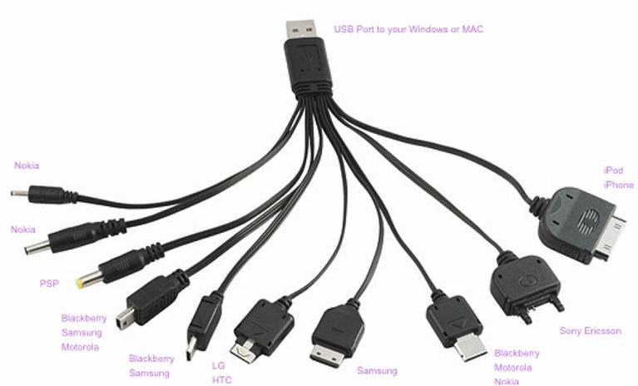
Universal Design for Learning (UDL)
UDL is a research based, proven framework found to assist educators in providing instruction to ELs (especially ELs with disabilities) that incorporates specially designed academic instruction in English (SDAIE).
UDL improves educational outcomes for ALL students by ensuring meaningful access to the curriculum within an inclusive learning environment.
UDL is a set of principles for delivering instruction and designing curricular materials in order to ensure that all individuals are provided equal opportunities to learn regardless of their disabilities or language differences.
Notes:
Joanna
All EL students should receive SDAIE, and, if necessary and reasonably possible, primary language support. School districts are required to continue to provide additional and appropriate educational services to ELs until they have met reclassification criteria.
UDL principles call for varied and flexible ways to present information so all students can access learning or the “what” of learning, plan learning tasks or the “how” of learning, as well as ways to provide engagement for students, or the “why” of learning Meyer (2002); CAST (2017).

Slide 32
UDL Principles
1) Multiple means of engagement – engage and motivate learners by offering choices of content and tools as well as by offering varying levels of challenge
1
2) Multiple means of representation – using a variety of methods to present information and provide a range of means to support various types of learners
2
3) Multiple means of action and expression – providing learners with alternative ways to act skillfully and demonstrate what they know
3
Notes:
Joanna

Slide 33
Notes:
Joanna-
See CAST handout ( in R Drive)
Refer to CAST website

Slide 34
L2: Motivating and Engaging English Learners
• Establish meaningful and engaging content learning goals around the essential ideas of a discipline as well as the specific learning processes students use to access those ideas.
• Provide a positive learning environment that promotes students’ autonomy in learning.
• Make literacy experiences more relevant to students’ interests, everyday life, or important current events.
• Build in certain instructional conditions, such as student goal setting, self-directed learning, and collaborative learning, to increase reading engagement and conceptual learning.
Notes:
Echo-Interest (relevance)
• Choice (autonomy and self determination)
• Success (self-efficacy or the belief that “I can do it”)
• Collaboration and real- world interactions (social relatedness and active engagement)
• Dedication (identification with being a good student, persistence, and willingness to work hard to achieve goals)
• Goal setting , self regulation, and guided self assessment
Create a welcoming classroom environment that exudes respectful or cultural and linguistic diversity
•Get to know students’ cultural and linguistic acknowledge and experiences and ow individual students interact with their home language and cultures
• se the primary language or home dialect of English as appropriate, to acknowledge them as valuable assets and to support all learners to fully develop academic English and engage meaningfully with the core curriculum
• Use texts that accurately reflect students’ cultural, linguistic, and social backgrounds so that students see themselves in the curriculum
• Continuously expand understanding s of cultures and languages so as not to oversimplif approaches to lturally responsive pedagogy

Slide 35
Reading: Motivating and Engaging English Learners
Help students discover the purpose and benefits of reading.
Create opportunities for students to see themselves as successful readers. Texts and tasks should be challenging, but within reach given appropriate teaching and scaffolding.
Provide students reading choices.
Provide students the opportunity to learn by collaborating with their peers to read texts, talk about texts, and engage in meaningful interactions with texts.
Notes:
Echo- motivation is very important. by modeling enjoyment of text and an appreciation of what information has to offer and by creating a print rich environment (including meaningful text on classroom walls and well stocked, inviting, and comfortable libraries or literacy centers that contain a range of print materials, including texts on topics relevant to instructional experiences children are having in the content areas).
which include allowing them choice on literacy-related activities, texts, and even locations in the room in which to engage with books independently. Teachers’ knowledge of their students’ abilities will enable them to provide appropriate guidance.
such as locating interesting information together. Similarly, a panel examining research on adolescent literacy (which begins in grade four) included increasing motivation and engagement as one of five recommendations. The panel’s report improving adolescent literacy: effective classroom and intervention practices

Slide 36
Equity For English Learners
LEAs must provide the personnel necessary to effectively implement EL programs.
Teachers who are qualified to provide EL services, core-content teachers who are highly qualified in their field as well as trained to support EL students, and trained administrators who can evaluate these teachers.
Adequate professional development and follow-up training in order to prepare EL program teachers and administrators to implement the EL program effectively.
Ensure that administrators who evaluate EL program staff are adequately trained to meaningfully evaluate whether EL teachers are appropriately employing their training in the classroom in order for the EL program model to successfully achieve its educational objectives.
Notes:
Echo

Slide 37
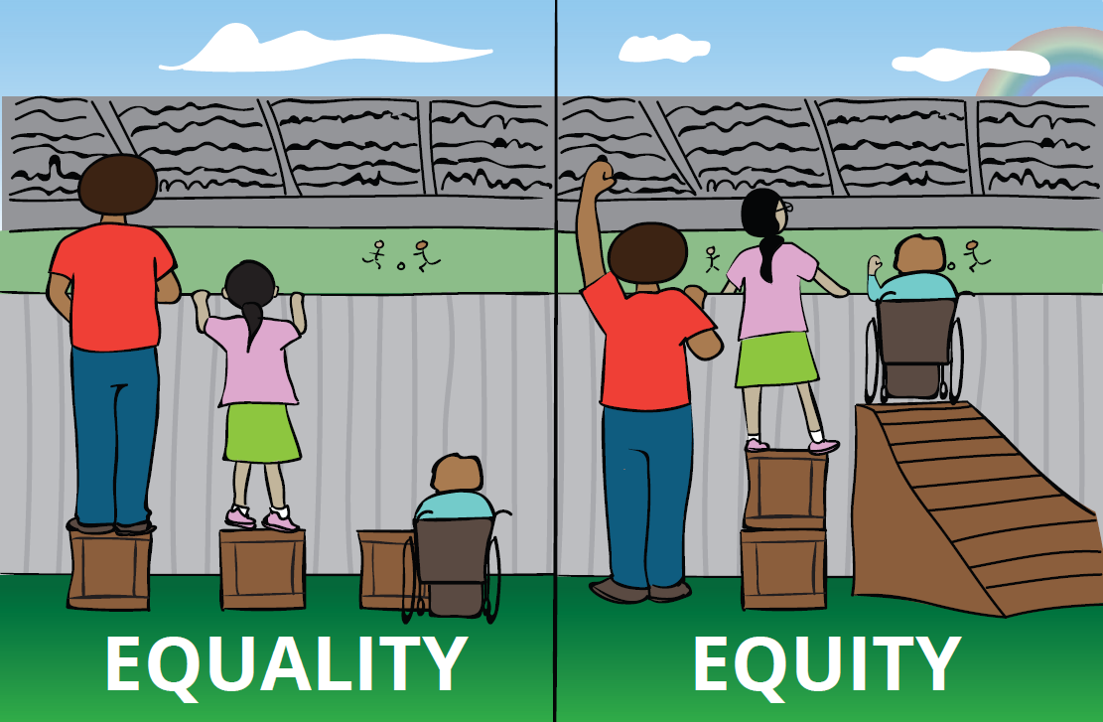
Equity for English Learners
LEAs must also:
Design and implement services and programs that enable ELs to attain both English proficiency and parity of participation in the standard instructional program, within a reasonable length of time.
Provide equal opportunities for EL students to meaningfully participate in curricular, co-curricular, and extracurricular programs and activities.
Use appropriate, reliable, and valid evaluations and testing methods to measure ELs’ acquisition of English and core-content knowledge.
Provide adequate and appropriate resources and materials for the EL programs.
Notes:
Echo

Slide 38
This Photo by Unknown Author is licensed under CC BY-NC-ND

